Slide 1
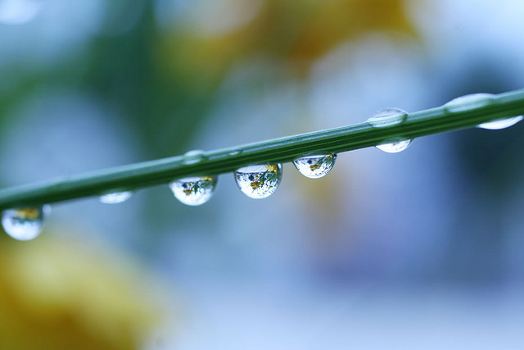
What Happens To The Water?
An inquiry to see how rainfall might behave differently when it lands on different surfaces in and around our school.
Image: Some rights reserved by fox_kiyo

Slide 2
In small groups of two or three students, you will simulate rain by pouring water onto different surfaces on the school grounds.
Your mission is to record, in detail, what happens to the water.

Slide 3
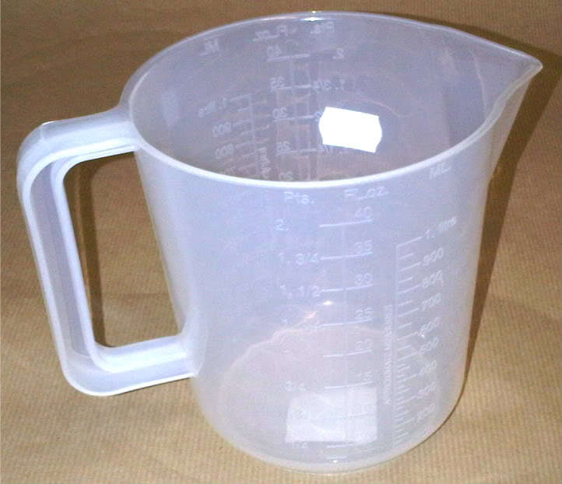
Each group will have one rain simulator.
Also known as a one litre measuring jug.

Slide 4
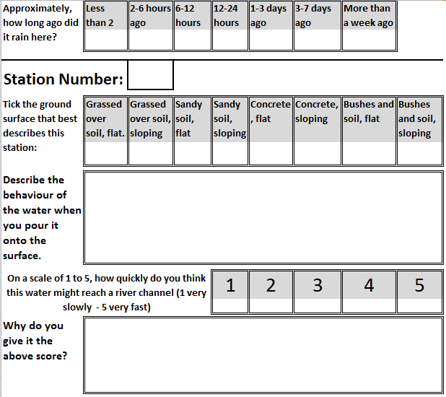
You will also have 4 recording sheets. Here is a part of one.

Slide 5
Why is it important to record when it last rained in this area?

Slide 6
For each ‘station’ you need to complete the following information. Check you understand the questions now.

Slide 7
The following slides show 7 possible locations for you to carry out the experiments at. There should be the same number of groups as stations and you should rotate around these stations when your teacher tells you to all move on at the same time. Take it turns to do the different jobs (such as pouring, observing and recording).

Slide 8
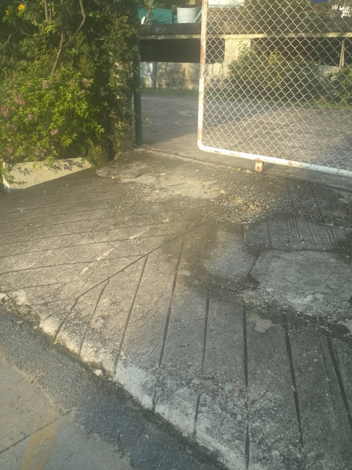
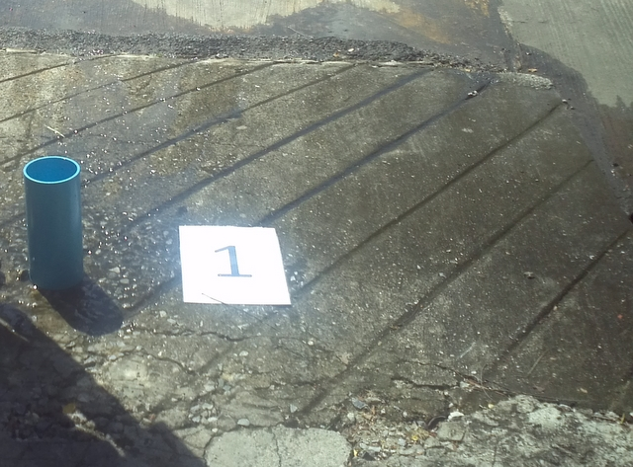
Site 1 – Sloping Concrete Surface

Slide 9
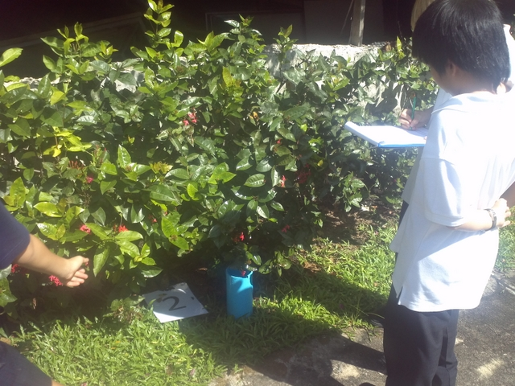
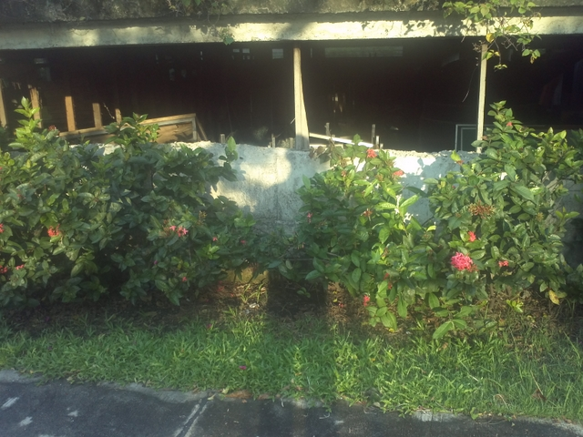
Site 2 – Soil Covered by Vegetation
You will pour the water on top of the plants

Slide 10
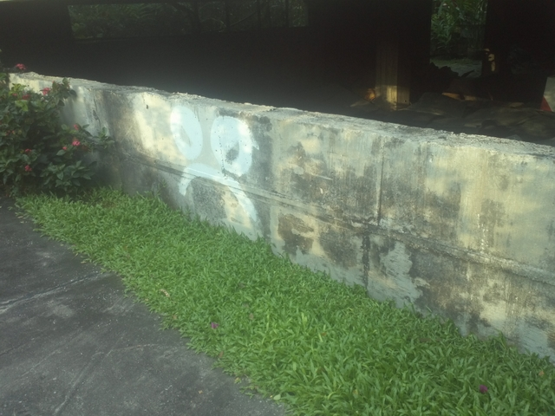
Site 3 – Flat Grassy Surface

Slide 11
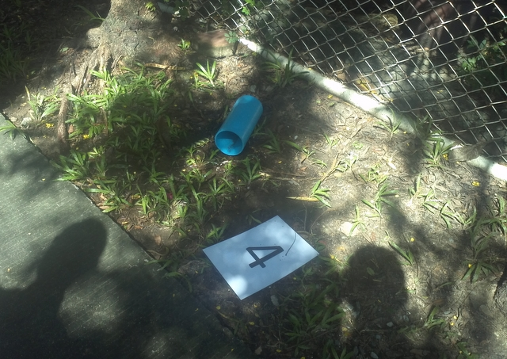
Site 4 – Flat Sandy Soil Surface with not much Vegetation

Slide 12
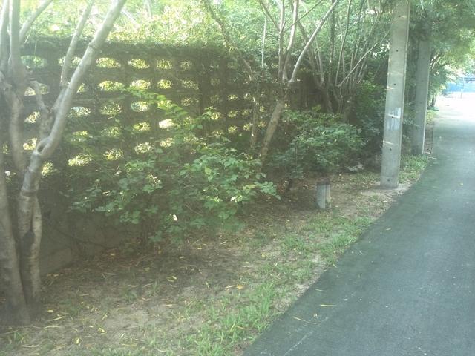
Site 5 – Sloping Sandy Soil Surface with not much Vegetation

Slide 13
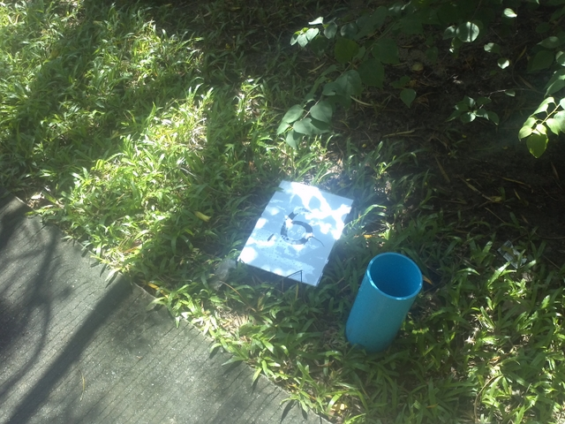
Site 6 – Sloping Grassy Surface

Slide 14
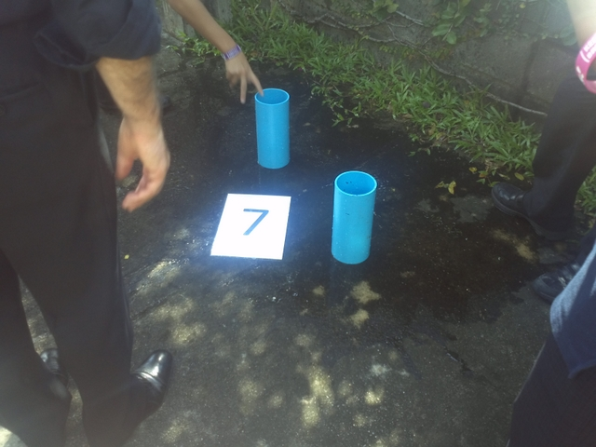
Site 7 – Flat Concrete Surface
How Does the Water Spread Out?

Slide 15
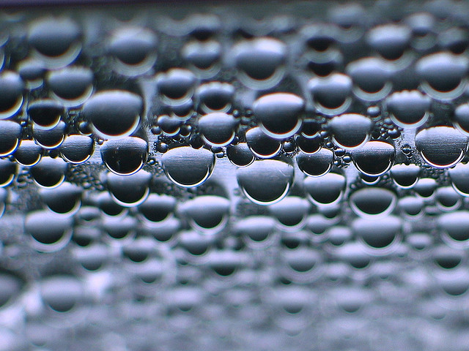
What words might you expect to use when looking at how water behaves when it is poured on these surfaces in the pictures you have just seen?
Image: Some rights reserved by Axel Rouvin

Slide 16
Infiltration
Surface Run-off
Surface Storage
Interception
Impermeable
Any others?
Image: Some rights reserved by Axel Rouvin

Slide 17
Before we go …
It can be hot especially if it is a sunny day. If you find that you are waiting around for other groups, do move to shady spots so that you are not in direct sunlight.
During the ‘experiments’ look very carefully – the more detail you can record the better.

Slide 18
Remember – you are working as part of a group. How might a group work best for everybody in that group?

